Slide 1
FINAL CAPSTONE • WEEK 6
AI-Assisted Recruitment
Automation
A human-in-the-loop AI pipeline that screens candidates, scores fit,
and keeps the final decision with a person — every time.
Sajeel Ali | Petalnex Pvt. Ltd. — AI Automation Internship | Day 36 — Final Presentation & Demo Day

Slide 2
The Business Problem
Manually screening job applications is slow and inconsistent. Recruiters spend significant time reading resumes, extracting relevant skills, and judging fit — a process prone to delay, reviewer fatigue, and inconsistent scoring across candidates.
100%
0
Ad-hoc
None
manual resume
reading & scoring
consistent rubric
applied across candidates
candidate
communication
structured
audit trail
Petalnex Pvt. Ltd. • AI Automation Internship • Day 36 Capstone
2

Slide 3
Existing Process & Pain Points
Today's process
Candidate applies
(email / ad-hoc form)
Recruiter manually
reads & extracts skills
Recruiter judges fit
(no fixed rubric)
Manual, inconsistent
follow-up email
Pain points
✕
Applications arrive through multiple channels with no central record
✕
Skills and experience extracted manually — slow and error-prone
✕
No consistent scoring rubric across candidates
✕
Recruiter manually tracks status across the pipeline
✕
Candidate communication sent manually and inconsistently
✕
No structured audit trail of who was evaluated, when, and why
Petalnex Pvt. Ltd. • AI Automation Internship • Day 36 Capstone
3

Slide 4
Proposed Solution
An automated pipeline that combines deterministic rules, AI judgment, and mandatory human approval.
1
Form Trigger
2
Validation
Candidate submits a structured application (n8n Form Trigger)
Deterministic field checks before anything costs an AI call
3
AI Scoring
4
Rule Engine
Gemini extracts skills and scores candidate fit, with reasoning
A deterministic rule score cross-checks the AI's recommendation
5
Human Review
6
Notify & Store
Recruiter sees both scores and makes the final call
Candidate notified by email; Supabase records the full audit trail
Petalnex Pvt. Ltd. • AI Automation Internship • Day 36 Capstone
4

Slide 5
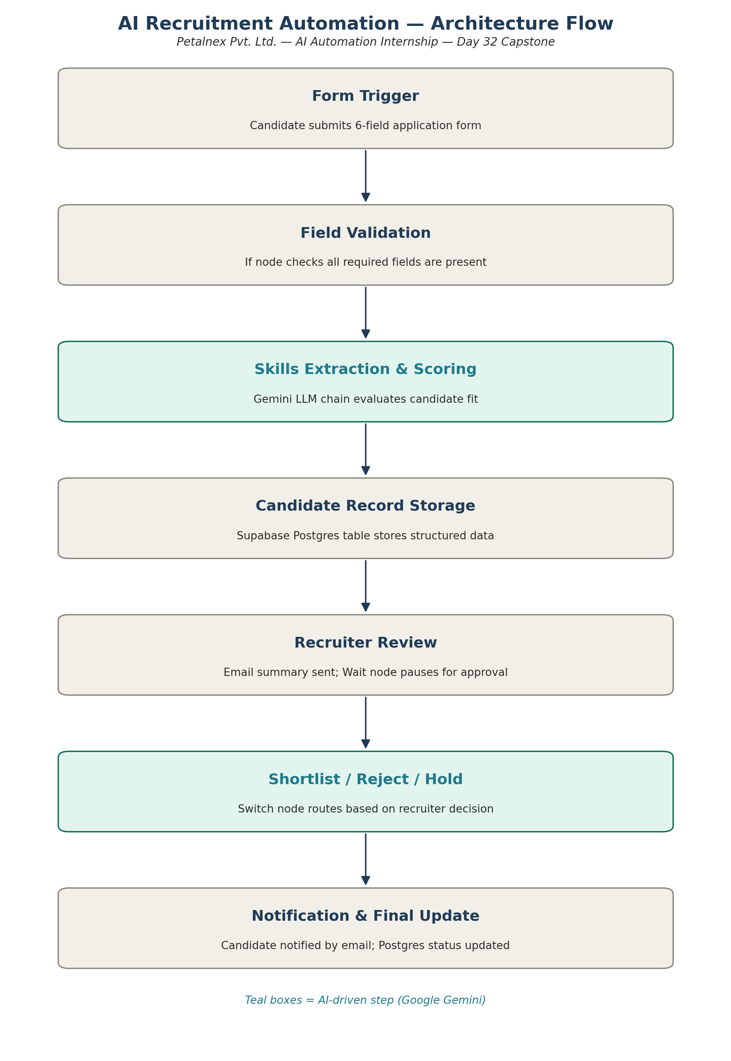
Solution Architecture
Seven stages carry the candidate from submission to a recorded, human-approved outcome. Teal stages are AI-driven; every other stage is deterministic.
•
Trigger
n8n Form Trigger collects a 6-field application
•
Storage
Supabase Postgres — full candidate + decision history
•
AI layer
Google Gemini scores fit with structured, reasoned output
•
Approval gate
Wait node pauses until a human decides
Petalnex Pvt. Ltd. • AI Automation Internship • Day 36 Capstone
5

Slide 6
Technologies & Components
Layer
Technology
Role in the pipeline
Orchestration
n8n (self-hosted)
Form Trigger, Code, If, Switch, Wait, Postgres, Send Email nodes
AI / LLM
Google Gemini
Skills extraction, fit scoring, structured reasoning
Data storage
Supabase (Postgres)
Candidate records, scores, decisions, full audit trail
Notifications
Gmail SMTP
Recruiter approval email + candidate outcome email
Petalnex Pvt. Ltd. • AI Automation Internship • Day 36 Capstone
6

Slide 7
AI Integration — Structured, Validated, Never Final
AI is used only where reasoning and judgment are genuinely needed — extracting skills and scoring fit. Everything before and after it is deterministic.
1
Gemini scores fit
Skills extraction + fit score + written reasoning, not just a number
Sample AI reasoning (real run)
“The candidate failed to list any of the required core skills (JavaScript, SQL, REST APIs) in their resume summary. The lack of technical detail makes it impossible to verify their fit for a senior engineering role.”
2
Parse & validate
Structured output is checked before anything downstream trusts it
3
Rule engine cross-checks
AI recommendation: Reject | Score: 10
A separate, deterministic rule score compares against the AI's call
Human decision: Shortlist (override)
4
Disagreement → Manual Review
Recorded in Supabase: final_status, decided_by, decision_notes, decided_at — the human's actual call, not the AI's suggestion.
AI and rule engine disagree? Escalated to a human, never silently resolved
Petalnex Pvt. Ltd. • AI Automation Internship • Day 36 Capstone
7

Slide 8
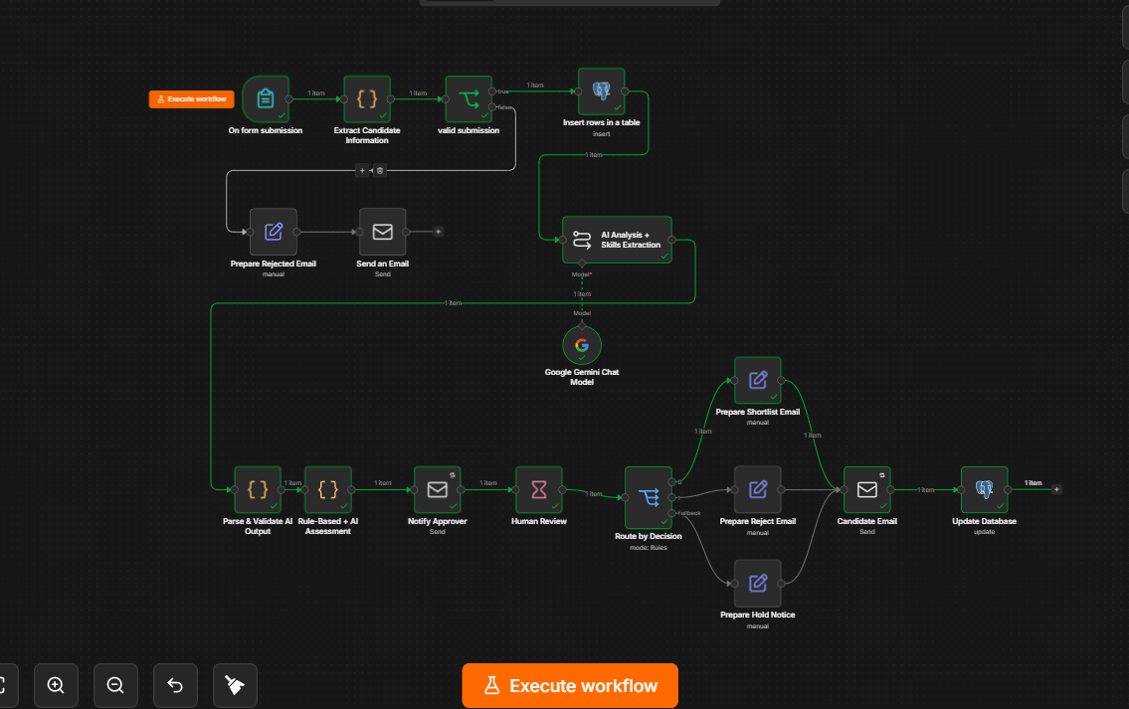
Live Demo
A single, real execution — every node green, start to finish.
✓
Form submitted → validated → stored
✓
Gemini scores skills & fit, with reasoning
✓
Rule engine cross-checks the AI's call
✓
Recruiter notified; workflow pauses for review
✓
Human decision recorded and routed
✓
Candidate emailed; database updated
Petalnex Pvt. Ltd. • AI Automation Internship • Day 36 Capstone
8

Slide 9
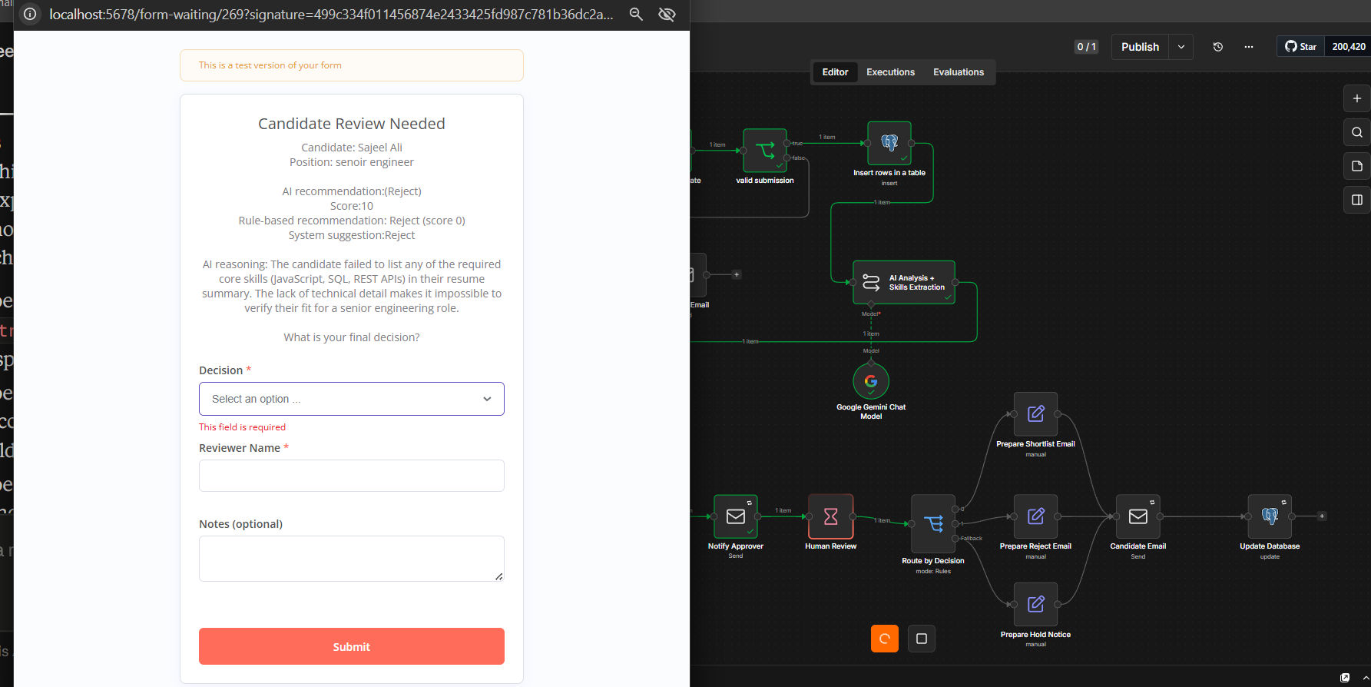
Human in the Loop, By Design
No candidate is finally shortlisted or rejected without a recruiter's explicit decision — even when the AI is confident.
•
Recruiter sees the AI score, the rule-based score, and the AI's written reasoning together
•
A single dropdown records the decision: Shortlist, Reject, or Hold for Manual Review
•
Reviewer name and optional notes are captured alongside the decision
•
The workflow pauses on a Wait node until this form is submitted — nothing proceeds without it
Petalnex Pvt. Ltd. • AI Automation Internship • Day 36 Capstone
9

Slide 10
Error Handling
Found through a structured 20-case test pass across six categories — and fixed, not just documented.
!
Deterministic validation first
!
Structured output before trust
Required fields checked before any AI call is made, so bad input never costs an API call
AI output is parsed and validated before any downstream node uses it
!
Switch fallback routing
!
Root-cause bug fixes
Decision values that don't match a defined rule are caught, not silently dropped
5 real bugs found via full workflow audit: field mis-mapping, a silent overwrite, and two emails missing their body
Petalnex Pvt. Ltd. • AI Automation Internship • Day 36 Capstone
10

Slide 11
Security
✓
Credential isolation
✓
Injection testing
All API keys and passwords live in n8n's credential store — never hardcoded in a node
Resume and name fields tested with script and SQL injection payloads; stored as plain text only
✓
No secret leakage
✓
Data minimization
Verified error messages, emails, and logs never expose API keys or passwords, even during induced failures
Only fields required for evaluation are stored; access restricted to authorized accounts
Petalnex Pvt. Ltd. • AI Automation Internship • Day 36 Capstone
11

Slide 12
Business Benefits
1
2
3
4
Faster screening
Consistent scoring
Full audit trail
Recruiter stays in control
AI scoring turns a manual read into seconds of structured analysis
Every candidate is judged against the same rubric, every time
Every decision — human or AI — is timestamped and recorded
AI assists judgment; it never replaces the final human call
Petalnex Pvt. Ltd. • AI Automation Internship • Day 36 Capstone
12

Slide 13
Limitations & Future Improvements
Current Limitations
Future Improvements
–
Rule engine's required-skills list is fixed per role, not configurable per posting
+
Configurable, per-role skill requirements instead of a fixed list
–
Email is the only match key for updating an existing candidate record
+
Interview scheduling step after Shortlist, via a calendar API
–
Gemini free-tier quota limits testing volume in a single session
+
Row-level uniqueness constraint on email to prevent duplicate candidates
–
No automated interview-scheduling step yet — routing ends at notification
+
A lightweight recruiter dashboard over the Supabase audit trail
Petalnex Pvt. Ltd. • AI Automation Internship • Day 36 Capstone
13

Slide 14
Thank You
AI-Assisted Recruitment Automation — built, tested, hardened, and demonstrated live.
Full repository & documentation:
github.com/SajeelALi2023632/petalnex-ai-automation-internship
Sajeel Ali | Petalnex Pvt. Ltd. — AI Automation Internship

